Slide 1
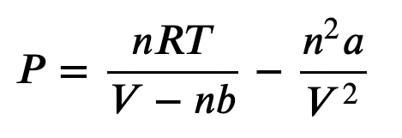
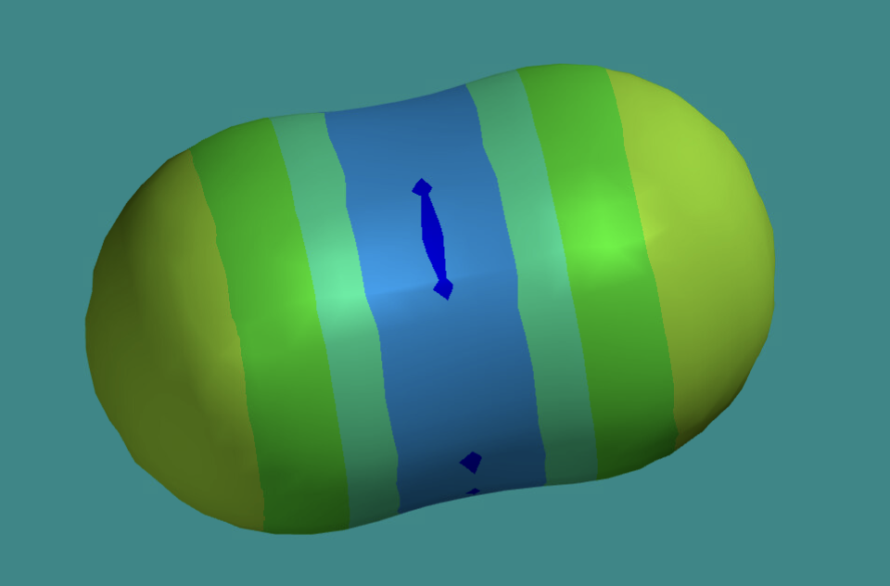

Recap: Thermodynamics and molecular insight
Macroscopic world
Microscopic world
The kinetic-molecular theory of gases
molecules are in constant motion
Slower-moving molecules=> lower temperature
Faster-moving molecules => higher temperature
-
-
+
Adiabatic heating & cooling
+
Intermolecular stickiness
-
-

Slide 2
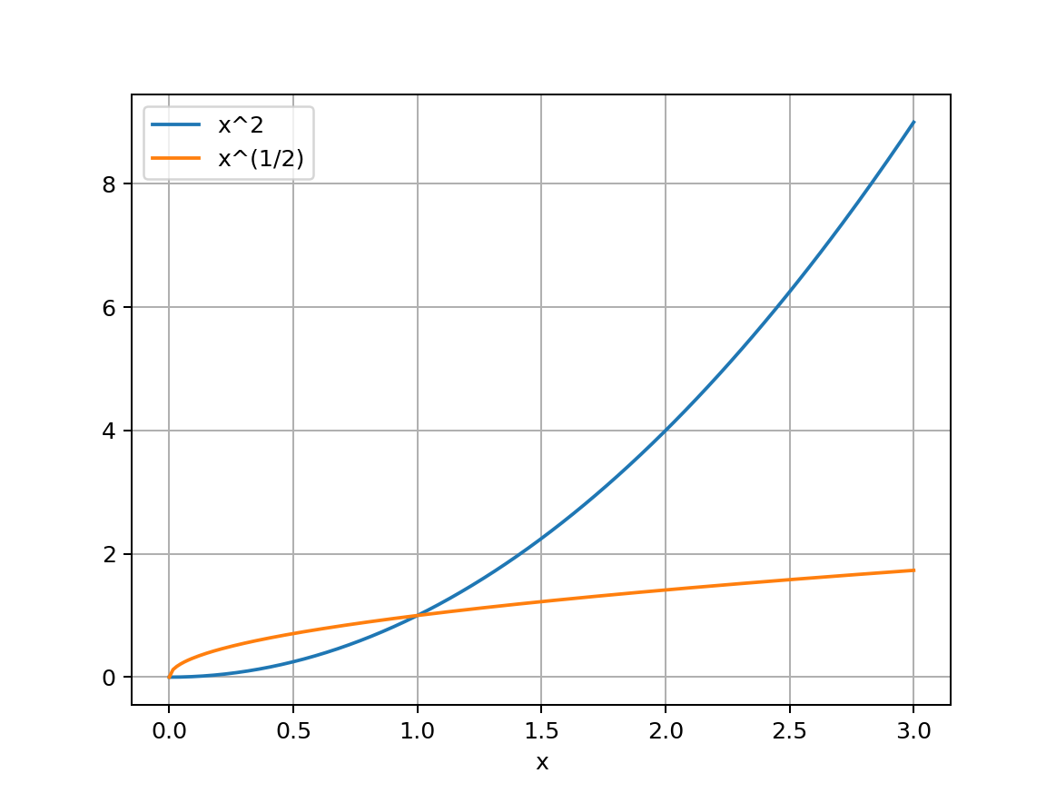
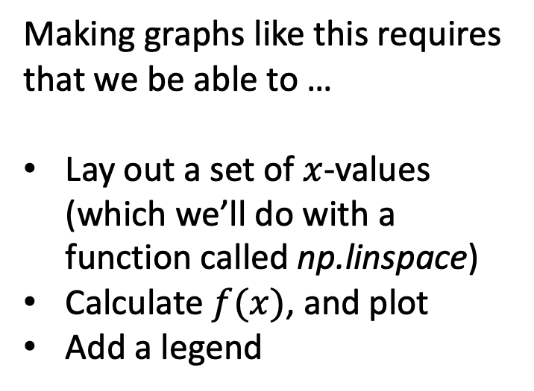
Today we’re going to get good at plotting 1D functions
Making graphs like this requires that we be able to …
Lay out a set of $x$-values (which we’ll do with a function called np.linspace)
Calculate $f(x)$, and plot
Add a legend

Slide 3
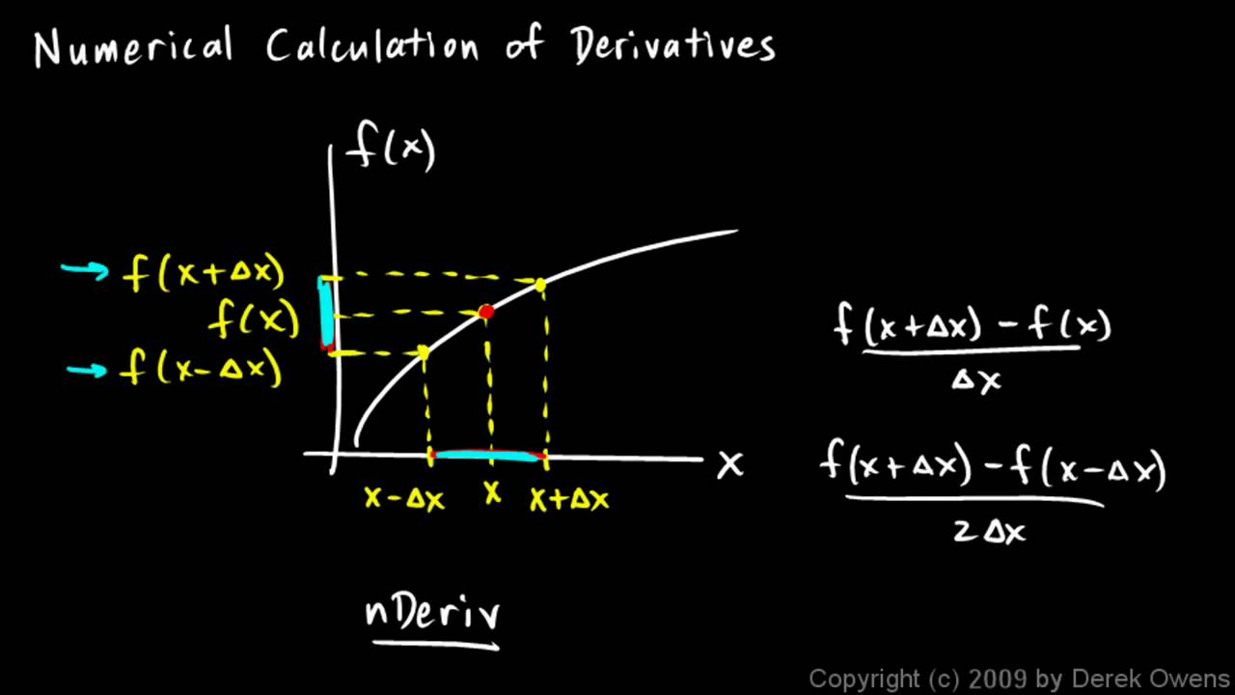

Also, how to take numerical derivatives
https://i.ytimg.com/vi/oi2mrzVu0AE/maxresdefault.jpg
A key idea here is that taking a numerical derivative in this way produces a new array that has one fewer value than the original $f(x)$.

Slide 4
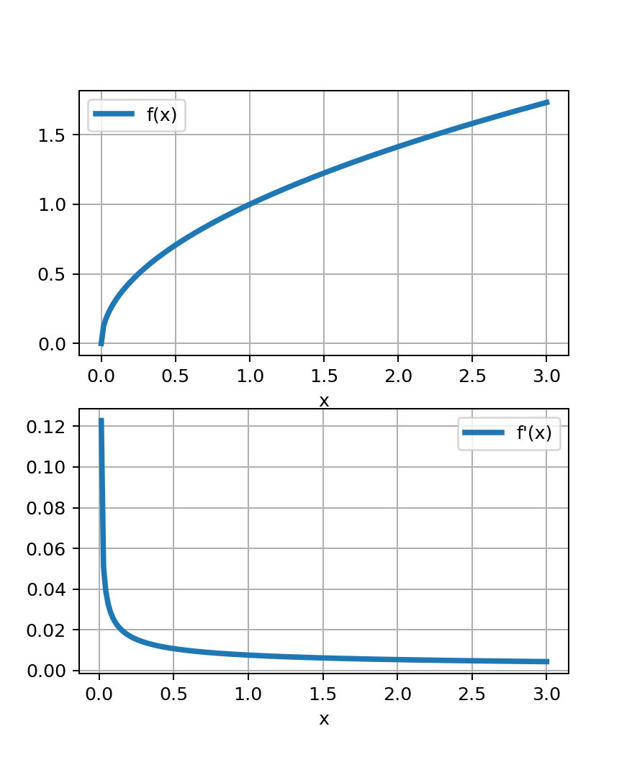
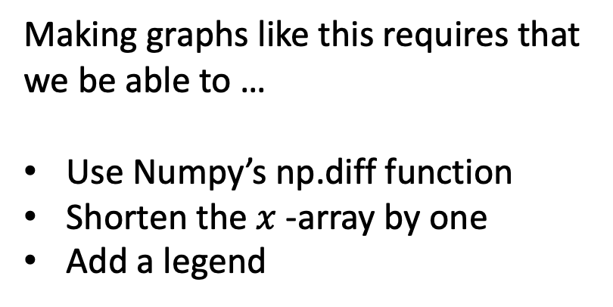
Also, how to take numerical derivatives
Making graphs like this requires that we be able to …
Use Numpy’s np.diff function
Shorten the $x$-array by one
Add a legend

Slide 5
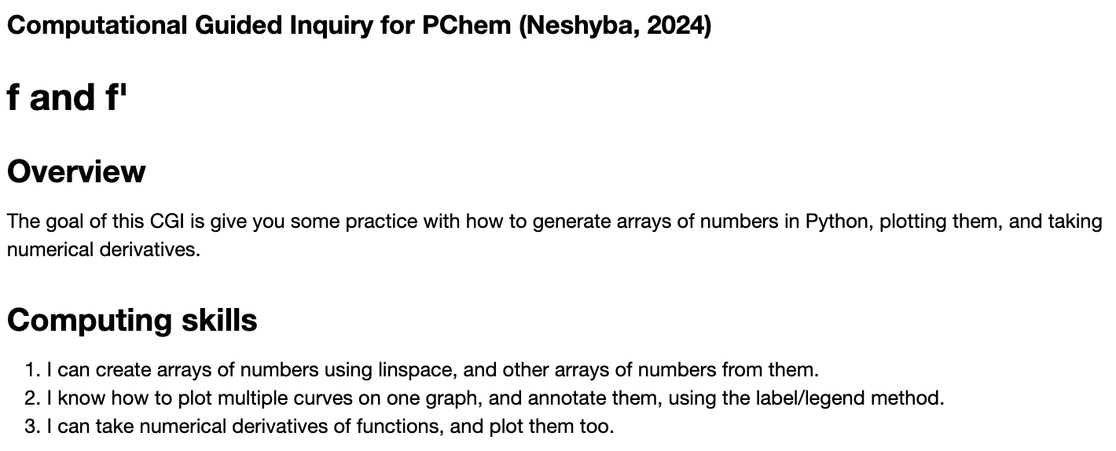
OK, let’s get started

